Slide 1
A Project on representation of vector using Raylib
1410 | Drishya Karki
Project Progress review – DWIT 035 – Class of 2028

Slide 2
Outline
Introduction
Problem Statement
Objective
Scope
Literature Review/Background Study
Methodology
Tools and Technology
Progress till now
Limitations (if any)
Result till now
Reference

Slide 3
Introduction
Overview: This project focuses on the practical application of C++ Standard Template Library (STL) components, specifically std::vector, within a real-time rendering engine (Raylib).
Core Application: A fully functional "Tetris" clone is developed to demonstrate dynamic memory management and coordinate manipulation.
Key Technologies:
  Language: C++ (Object-Oriented Programming).
  Library: Raylib (For graphics and input handling).
  Logic: Utilization of std::vector for managing dynamic game states (block rotations, color palettes).

Slide 4
Problem Statement
The Challenge: Managing game entities that change shape and size (like Tetrominoes) using static arrays is inefficient and prone to errors.
The "Static" Limitation: Standard arrays (int arr[10]) cannot resize or easily handle complex key-value pairings needed for rotation states.
The Need: A dynamic container is required to:
  Store variable lists of colors.
  Manage coordinate pairs (Position) for different rotation states.
  Handle game logic without hard-coding every single pixel.

Slide 5
Objective
Develop a robust game “Tetris” using C++ and Raylib.
Implement the std::vector container to manage dynamic game data:
Demonstrate Object-Oriented principles (Inheritance, Encapsulation) through the Grid and Block class architecture.

Slide 6
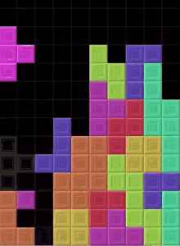
Scope
1. Functional Scope (The Game Features) :
  Core Gameplay: A fully functional implementation of the classic Tetris game mechanics, including block spawning, gravity, and locking.
  Dynamic Controls: Real-time user input handling for moving (Left/Right), rotating (Up), and accelerating (Down) the active piece.
  Game Physics: robust collision detection system that prevents blocks from moving through walls or overlapping with existing grid cells.
  Line Clearing Logic: Automated detection and clearing of completed rows, with existing blocks shifting down dynamically.

Slide 7
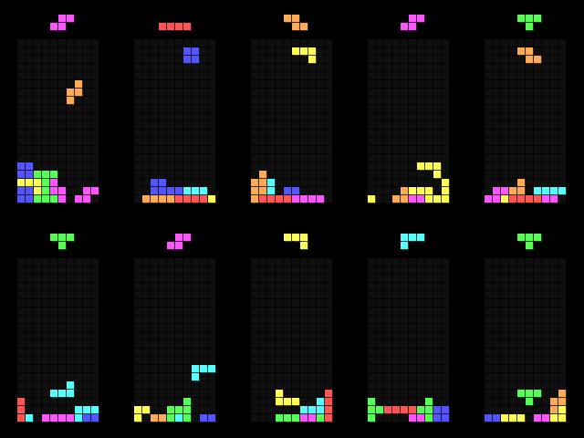
Scope
Technical Scope (The "Vector" Implementation) :
  Dynamic Memory Management: Utilization of C++ std::vector to manage variable lists of block coordinates and color palettes efficiently.
  Object-Oriented Architecture: extensive use of Inheritance (Child classes like Lblock, TBlock) and Encapsulation to modularize game logic.
  2D Rendering Engine: Implementation of a custom rendering loop using Raylib to visualize abstract data structures (Arrays/Vectors) as graphical elements.

Slide 8
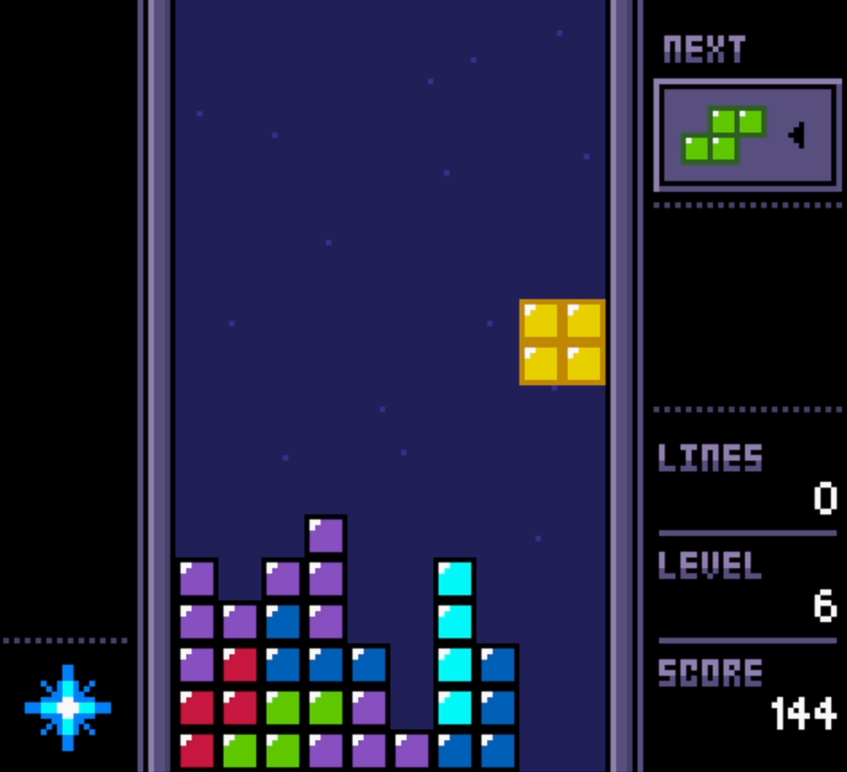
Scope
Future Scope (Roadmap)
  Audio Integration: Adding sound effects for rotation, movement, and line clears (using Raylib's Audio module).
  UI Enhancements: Developing a "Main Menu," "Pause Screen," and a persistent "High Score" system.

Slide 9
Literature Review/Background Study
Gaming History: Tetris (1984) established the standard for grid-based puzzle mechanics using "tetrominoes."
Library Selection: Raylib offers superior abstraction for educational prototyping compared to low-level drivers like SDL.
Data Structures: std::vector provides essential dynamic memory management for handling complex, rotating shapes.

Slide 10
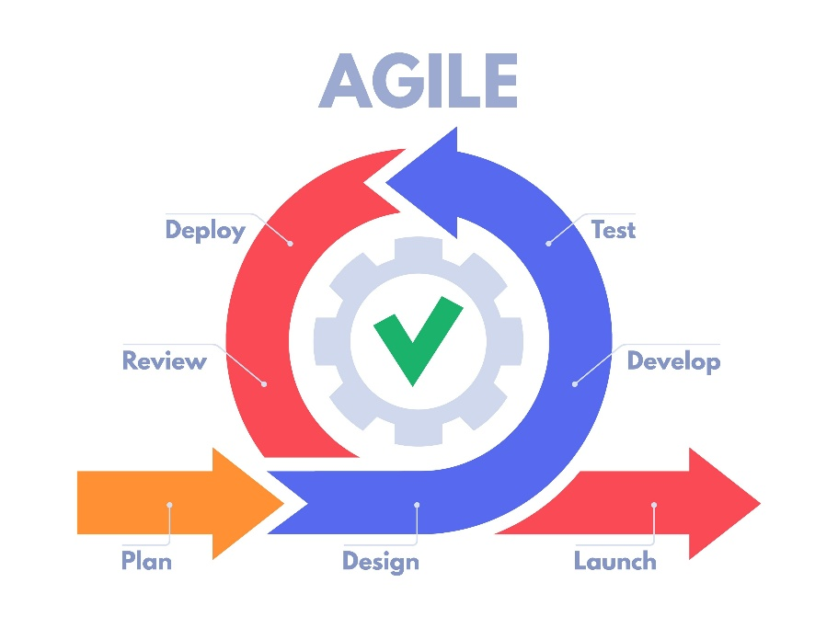
Methodology
Work flow Model : Iterative and Incremental workflow (Agile)
  First created grid
  Added colors and blocks
  Added game logic
  Now Fixing Bugs

Slide 11
Methodology
Functional Requirements :
  Game Board rendering: The system must render a 20-row by 10-column grid where each cell is 30x30 pixels.
  Block Spawning: The game must randomly generate and spawn one of the 7 Tetromino shapes (I, J, L, O, S, T, Z) at the top of the grid.
  Player Movement Control: The user must be able to move the active block Left, Right, or Down using the keyboard arrow keys.
  Block Rotation: The user must be able to rotate the active block 90 degrees by pressing the Up arrow key.
  Collision Detection: The system must prevent blocks from moving outside the game boundaries or overlapping with existing blocks on the grid.
  Automatic Gravity: The active block must move down automatically at a set interval (currently every 0.2 seconds).
  Row Clearing: When a horizontal row is completely filled with blocks, the system must clear that row and shift all blocks above it down.
  Next Block Logic: The system must generate the "Next Block" in advance and switch it to the "Current Block" once the previous block locks into place.

Slide 12
Methodology
Non-Functional Requirements :
  Performance (FPS): The game must run at a stable 60 Frames Per Second (FPS) to ensure smooth animations and responsive controls.
  Response Time: The game loop must process user input and render updates instantly (within the 16.6ms frame window) to prevent input lag.
  Modularity (Maintainability): The codebase must follow Object-Oriented Programming (OOP) principles, separating logic into distinct classes (Grid, Block, Game) for easier debugging and future updates.
  Platform Compatibility: The application must be compilable and executable on Windows systems using the MinGW (G++) compiler.
  Reliability: The system must handle edge cases, such as preventing rotation near walls ("Wall Kicks") or stopping movement when the grid is full, without crashing.
  Scalability: The use of dynamic data structures (std::vector) allows for easy addition of new block types or colors without rewriting the core engine..

Slide 13
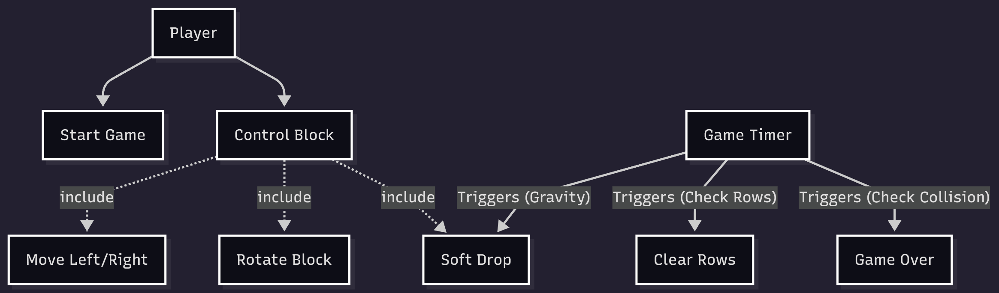
Methodology
Use Case Diagram

Slide 14
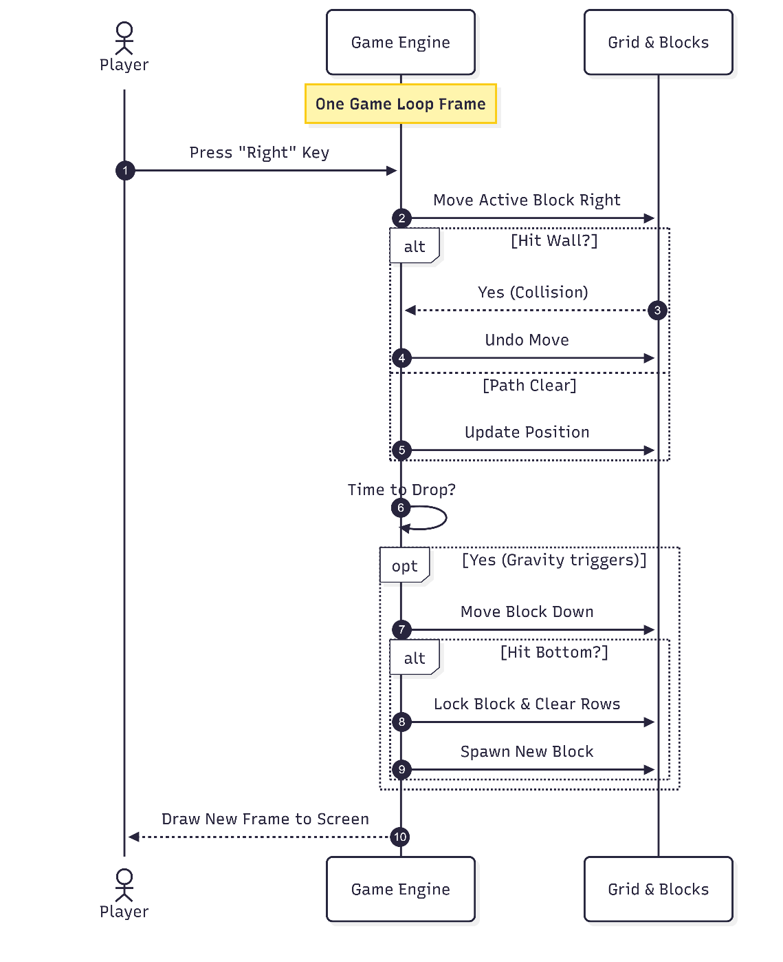
Methodology
Sequence Diagram
  Start: The game loop begins a new frame (1/60th of a second).
  Input: The player presses a specific key (e.g., Right Arrow).
  Action: The Game Engine updates the Active Block's coordinates.
  Validation: The Engine checks if the new position overlaps a wall or block.
  Correction: If a collision is found, the movement is immediately undone.
  Gravity Check: The Engine checks if the 0.2-second drop timer has passed.
  Drop: If time is up, the Active Block is moved down one row.
  Landing Check: The Engine checks if the block has hit the floor.
  Lock & Clear: If landed, the block is saved to the Grid, and full rows are cleared.
  Render: The Engine draws the updated Grid and Block to the screen.

Slide 15
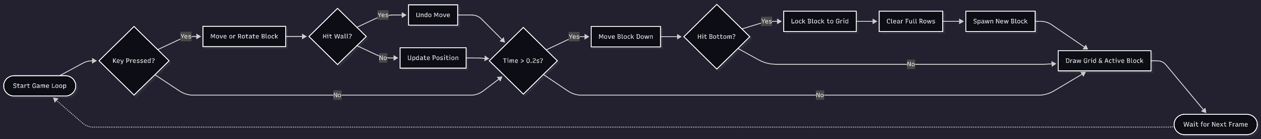
Methodology
Flowchart
Fig. Hierarchical Flowchart
Fig. Adaptive Flowchart

Slide 16
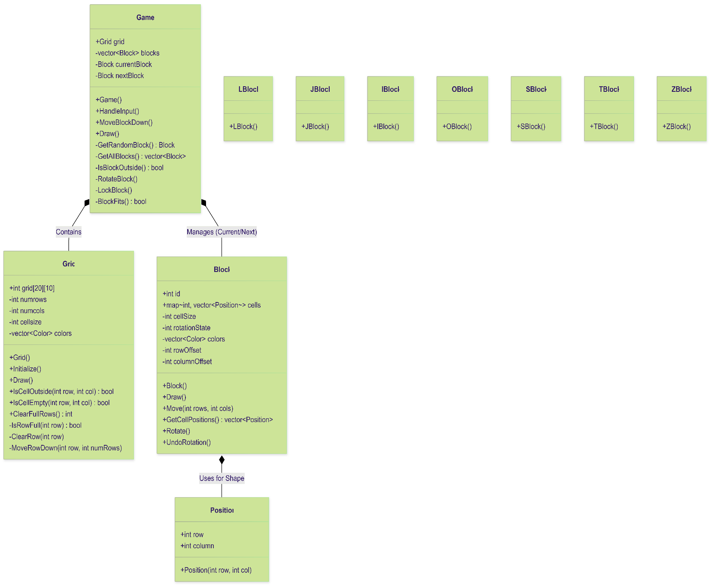
Methodology
Class Diagram
  The Game class acts as the central engine, owning and managing instances of the Grid and Block classes.
  The Game listens for user input to control the Block (the active piece) via movement and rotation logic.
  The Block class relies on a vector of Position objects to define its shape and location.
  The Game validates the Block's potential moves against the Grid's boundaries and occupied cells.
  When a block lands, the Game transfers its color ID into the Grid's 2D array to lock it in place.
  The Game orchestrates rendering by drawing the Grid's saved state first, then overlaying the active Block.
  The Grid independently handles row clearing and shifting logic once pieces are locked.

Slide 17
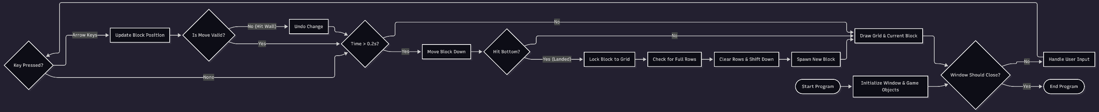
Methodology
Activity Diagram:
Fig. Hierarchical Flowchart
Fig. Adaptive Flowchart

Slide 18
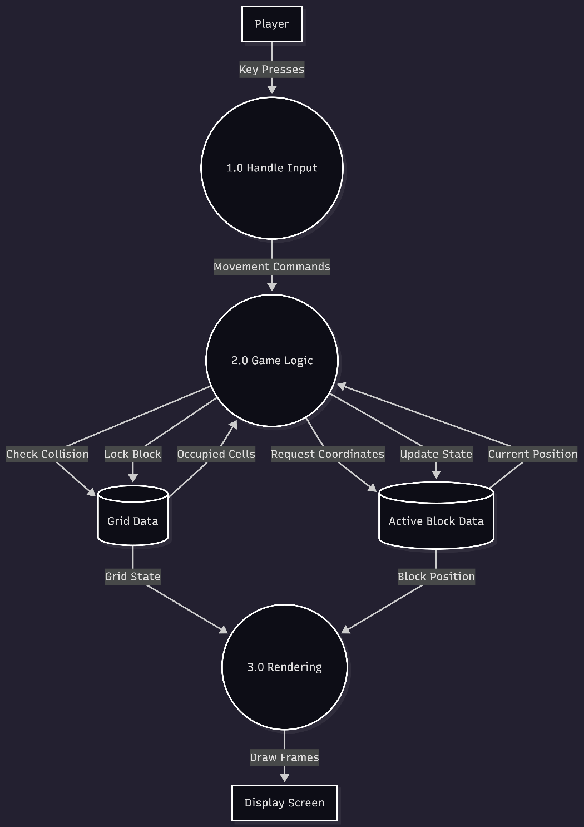
Methodology
Data Flow Diagram (DFD)
  Player Input (Key Presses) → Handle Input Function: Raw key presses are sent to the input handler.
  Handle Input → Movement Commands (Vectors): Key presses are converted into coordinate changes (e.g., x-1, y+0).
  Movement Commands → Game Logic: These coordinate changes are sent to the main game logic to be processed.
  Game Logic ↔ Grid Data (2D Array): The logic reads the grid to check for collisions and writes to the grid when a block locks.
  Game Logic ↔ Active Block Data: The logic constantly updates the row, column, and rotation of the current block.
  Grid Data & Active Block Data → Rendering System: The renderer pulls the final positions and colors from both data sources.
  Rendering System → Display Screen: The combined data is drawn as pixels on the user's screen.

Slide 19
Tools and Technology
C++: The core programming language used for logic, object-oriented structure, and memory management.
Raylib: The graphics library used for hardware-accelerated 2D rendering and handling keyboard input.
Visual Studio Code: The primary code editor used for writing and organizing the project files.
MinGW (G++): The compiler used to translate the C++ source code into a Windows executable.
Mermaid.js: The tool used to generate the system architecture diagrams (Class, Sequence, and Activity diagrams).
Command Prompt/Terminal: Used to execute the build scripts and run the compiled game.

Slide 20
Progress till now
Environment Setup: Configured the C++ development environment and integrated the Raylib library for 2D rendering and input management.
Grid Module: Completed the Grid class, establishing the 20x10 matrix logic for cell state management and background rendering.
Block Architecture: Developed the object-oriented hierarchy, including the base Block class and the inherited specific tetromino shapes.
Dynamic Rotation: Integrated std::vector and std::map to handle and store the various rotation states for all block types.
Movement Logic: Implemented the core algorithms for horizontal movement, rotation, and vertical descent (gravity).
System Integrity: Finalized collision detection logic and the row-clearing process to ensure correct grid updates during gameplay.

Slide 21
Limitations
Fixed Data Structure: The game is hard-coded to a 20x10 grid, meaning it cannot dynamically adapt to different screen sizes or custom board dimensions without a code rewrite.
Lack of "Wall Kicks": Your rotation logic is strict; if a block is against a wall where a rotation would overlap, the rotation simply fails rather than "kicking" the block slightly inward to fit.
No Persistent Storage: There is no database or file handling (like JSON or SQL) to save high scores, meaning all data is wiped the moment the game window is closed.
Static Difficulty: The "Gravity" timer is constant; the project lacks a leveling algorithm to increase the speed and difficulty as the player's score increases.

Slide 22
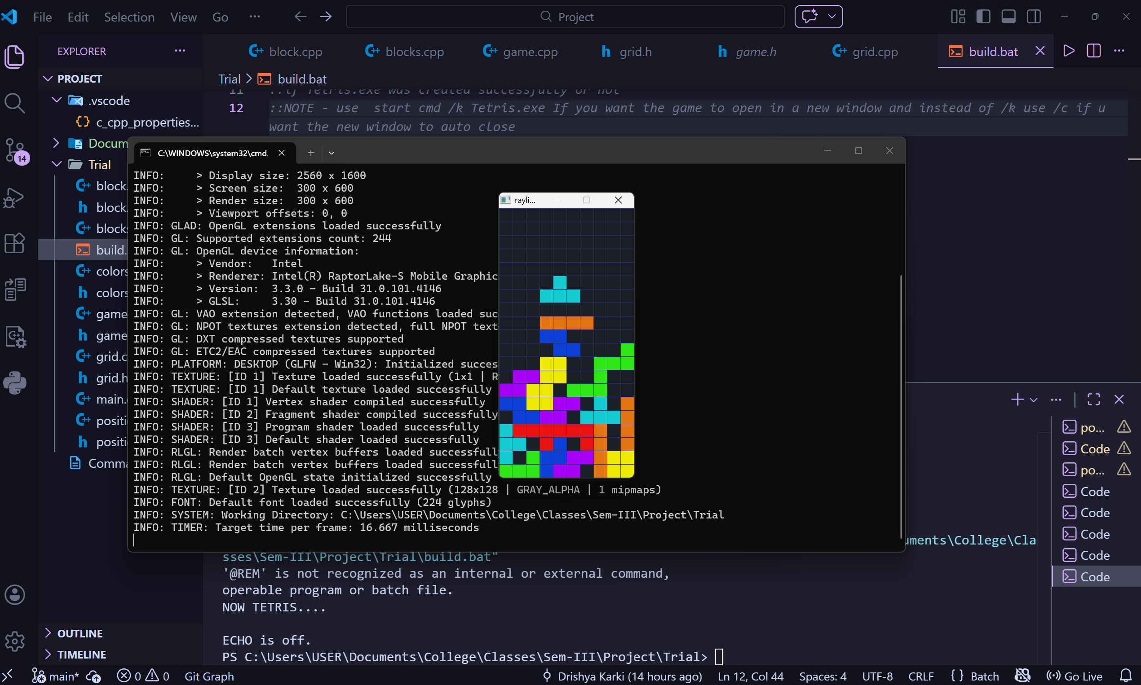
Result

Slide 23
References
Programming Tutorial: "Creating Tetris in C++ with raylib - Beginner Tutorial (OOP)" by Nick Goudard (YouTube).
Official Documentation: raylib.com – The official API reference for drawing, input, and window management.
Game Mechanics Study: "Tetris is Hard, Even to Approximate" – A research paper on the computational complexity of the game.

Slide 24
DEMO!!!!!

Slide 25
Thank You!!!!!

